Slide 1


Mealtime with Toddlers… Less Stress, More Fun!
*Portion Size
*Rituals and Routines
*Healthy food choices

Slide 2
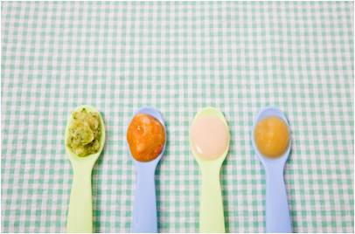
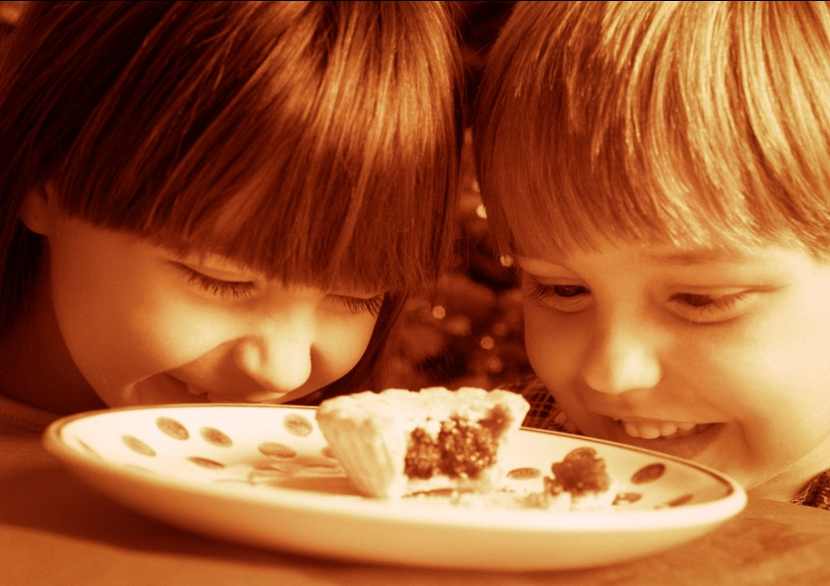
During your child’s first year of life he/she grew extremely fast. After the first year, however, your child’s growth will slow and their appetite will probably decrease
Keep in mind that toddlers eat toddler size portions! Their stomach does not have the capacity to eat the same portion sizes as adults.
Rule of thumb…serving size equals about one tablespoon per year of age

Slide 3
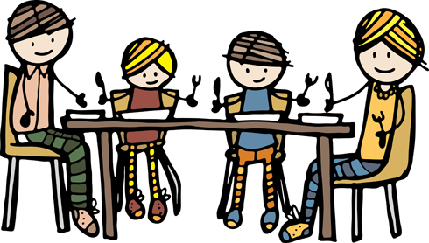
Routine can help establish good eating habits.
Routines also give children a sense of organization, stability and comfort.
New foods are better accepted when they are served when the child is hungry
Family mealtime provides parents the opportunity to model healthy eating behaviors for their child
Your toddler will be more likely to try something new if it is the same food that the family is eating.

Slide 4
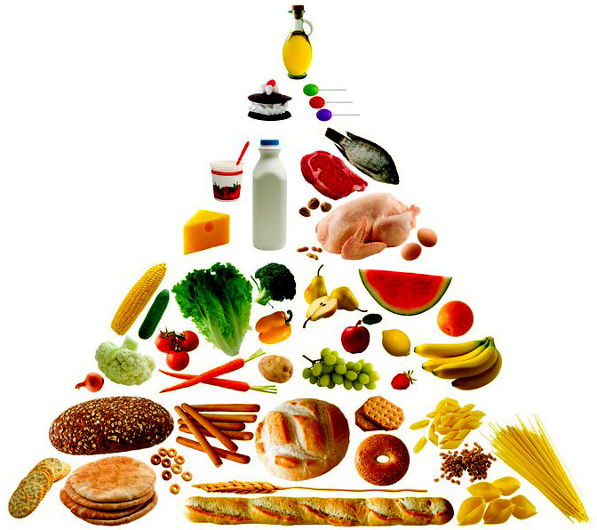
Iron is a vital mineral for human function. Iron is a nutrient that's needed to make hemoglobin, the oxygen-carrying component of red blood cells . Therefore, in order to remain healthy, toddlers need 7 milligrams of iron each day
Healthy, well-timed snacks can help balance out an uneven diet. Many Toddlers like foods that are slightly sweet or slightly salty. Instead of candies or processed foods, try sweet fruits such as watermelon and tasty vegetables such as cucumbers.
Fruits and Veggies: About 4 servings per day
Protein: 2 servings per day (13 g/d)
Grains: 4 servings per day
Water: 1.3 L/d

